Slide 1
We will be starting soon!
Thanks for joining us

Slide 2
Modeling All-Electric Homes in the 2022 Energy Code
Nick Brown – Build Smart Group
November 14, 2024
Notes:
PRESS RECORD
Good morning everyone,
Thanks for joining us! My name is Naomi Newman with 3C-REN. I have started recording this course which will be posted on 3C-RENs On-Demand page.
We have Nick Brown with us today to talk about modeling all ectric homes in the 2022 energy code
Before we get going, I just have a few slides to run through.

Slide 3
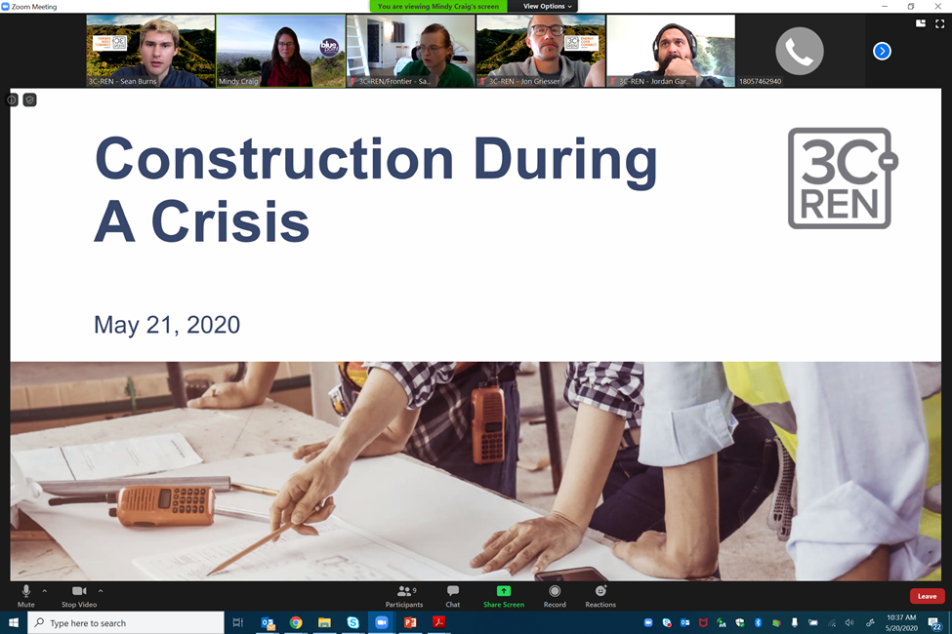
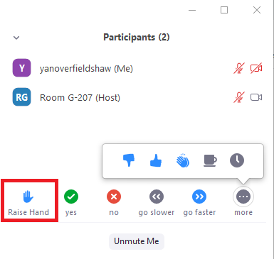
Zoom Orientation
Please be sure your full name is displayed
Please mute upon joining
Use "Chat“ box to share questions or comments
Under "Participant" select "Raise Hand"
to share a question or comment verbally
The session may be recorded and posted to 3C-REN's on-demand page. Feel free to ask questions via the chat and keep video off if you want to remain anonymous in the recording.
Notes:
we ask that everyone make sure they are on mute throughout the duration of the course. If you would like to verbally participate, please raise your hand in the participant's section and we will call on you to unmute yourself.
We encourage you to participate and ask questions through the chat box as well

Slide 4
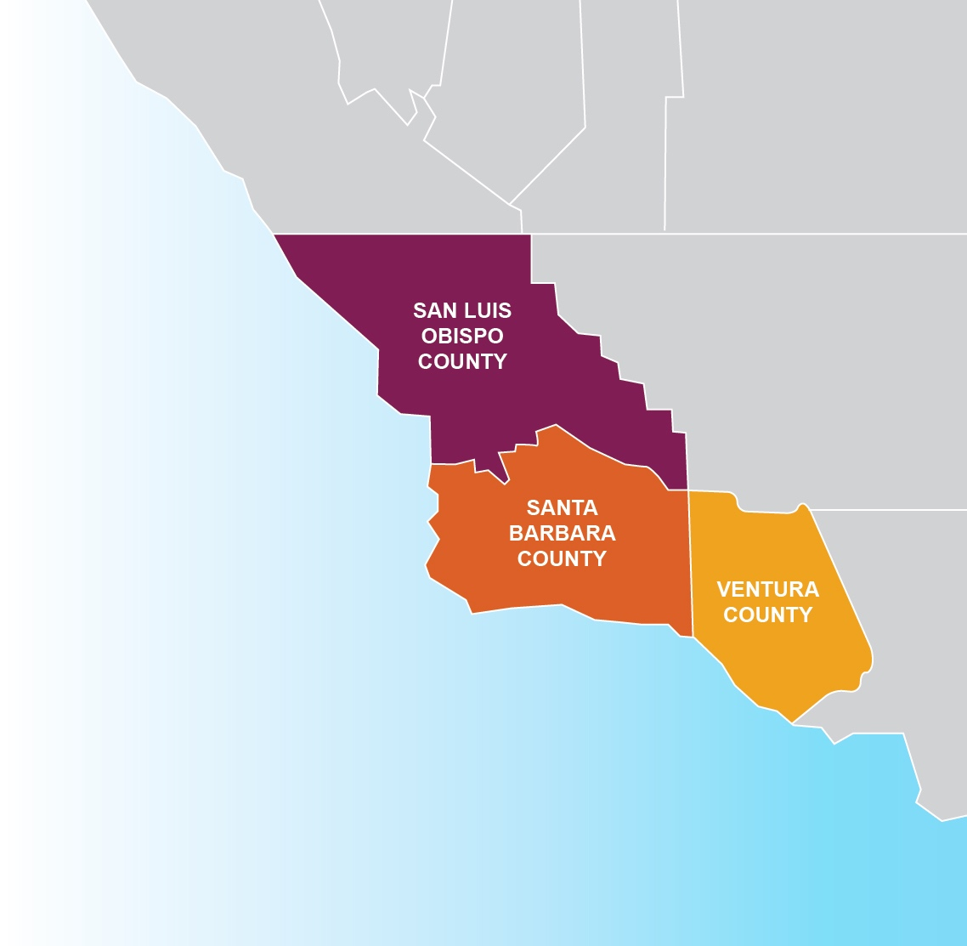



3C-REN: Tri-County
Regional Energy Network
  Three counties working together to improve energy efficiency in the region
  Services for –
    Building Professionals: industry events, training, and energy code compliance support
    Households: free and discounted home upgrades
  Funded by ratepayer dollars that 3C-REN returns to the region
Notes:
A few words about who we are
We are the Tri-County Regional Energy Network, aka 3C-REN
We are a collaborative partnership between San Luis Obispo, Santa Barbara and Ventura Counties
Working to improve energy efficiency in our region by offering free programs and services for building professionals and households
3C-REN is funded by ratepayer dollars which are collected through the Public Goods Charge found on our utility bills.
The benefit of being ratepayer funded is that there is no cost to those we serve
And we are able to return these dollars back to our local economy which has historically missed out on some of these funds.
3C REN currently offers 3 programs

Slide 5


  Serves all building professionals
  Three services –
    Energy Code Coach
    Training and Support
    Regional Forums
  Makes the Energy Code easy to follow
Energy Code Coach:
3c-ren.org/codes
805.781.1201
Event Registration:
3c-ren.org/events
Notes:
The Energy Code Connect program serves building professionals by offering Title 24 Part 6 and Part 11 support. Within the Energy Code Connect program, we offer :
Energy Code Coach service-
an over the phone, online, and in the field support for both Residential and non-residential projects
Trainings and support
We also offer online courses and regional forums that are designed to increase overall energy code comprehension, compliance, and enforcement

Slide 6


  Serves current and prospective building professionals
  Expert instruction:
    Technical skills
    Soft skills
  Helps workers to thrive in an evolving industry
Event Registration:
3c-ren.org/events
Notes:
Another program we offer is Building Performance Training which serves building by offering technical and soft skill trainings related to building science principles, high performance buildings, marketing, and communication techniques.

Slide 7


  Multifamily (5+ units)
  No cost technical assistance
  Rebates up to $750/apartment plus additional rebates for specialty measures like heat pumps
  Single Family (up to 4 units)
  Sign up to participate!
  Get paid for the metered energy savings of your customers
Enrollment:
3C-REN.org/contractor-participation
Notes:
And we have our Home Energy Savings program which incentivizes contractors and helps residents save money and make their homes healthier with energy efficient upgrades through incentives and rebates.
With that, I’ll pass things over to Jennifer.

Slide 8
Modeling All-Electric Homes in the 2022 Code
November 14, 2024
How to model an all-electric home that is: healthier, safer and more affordable, efficient, comfortable, and resilient
Please sign into the chat and tell us where you are from and what you would like to learn today!

Slide 9
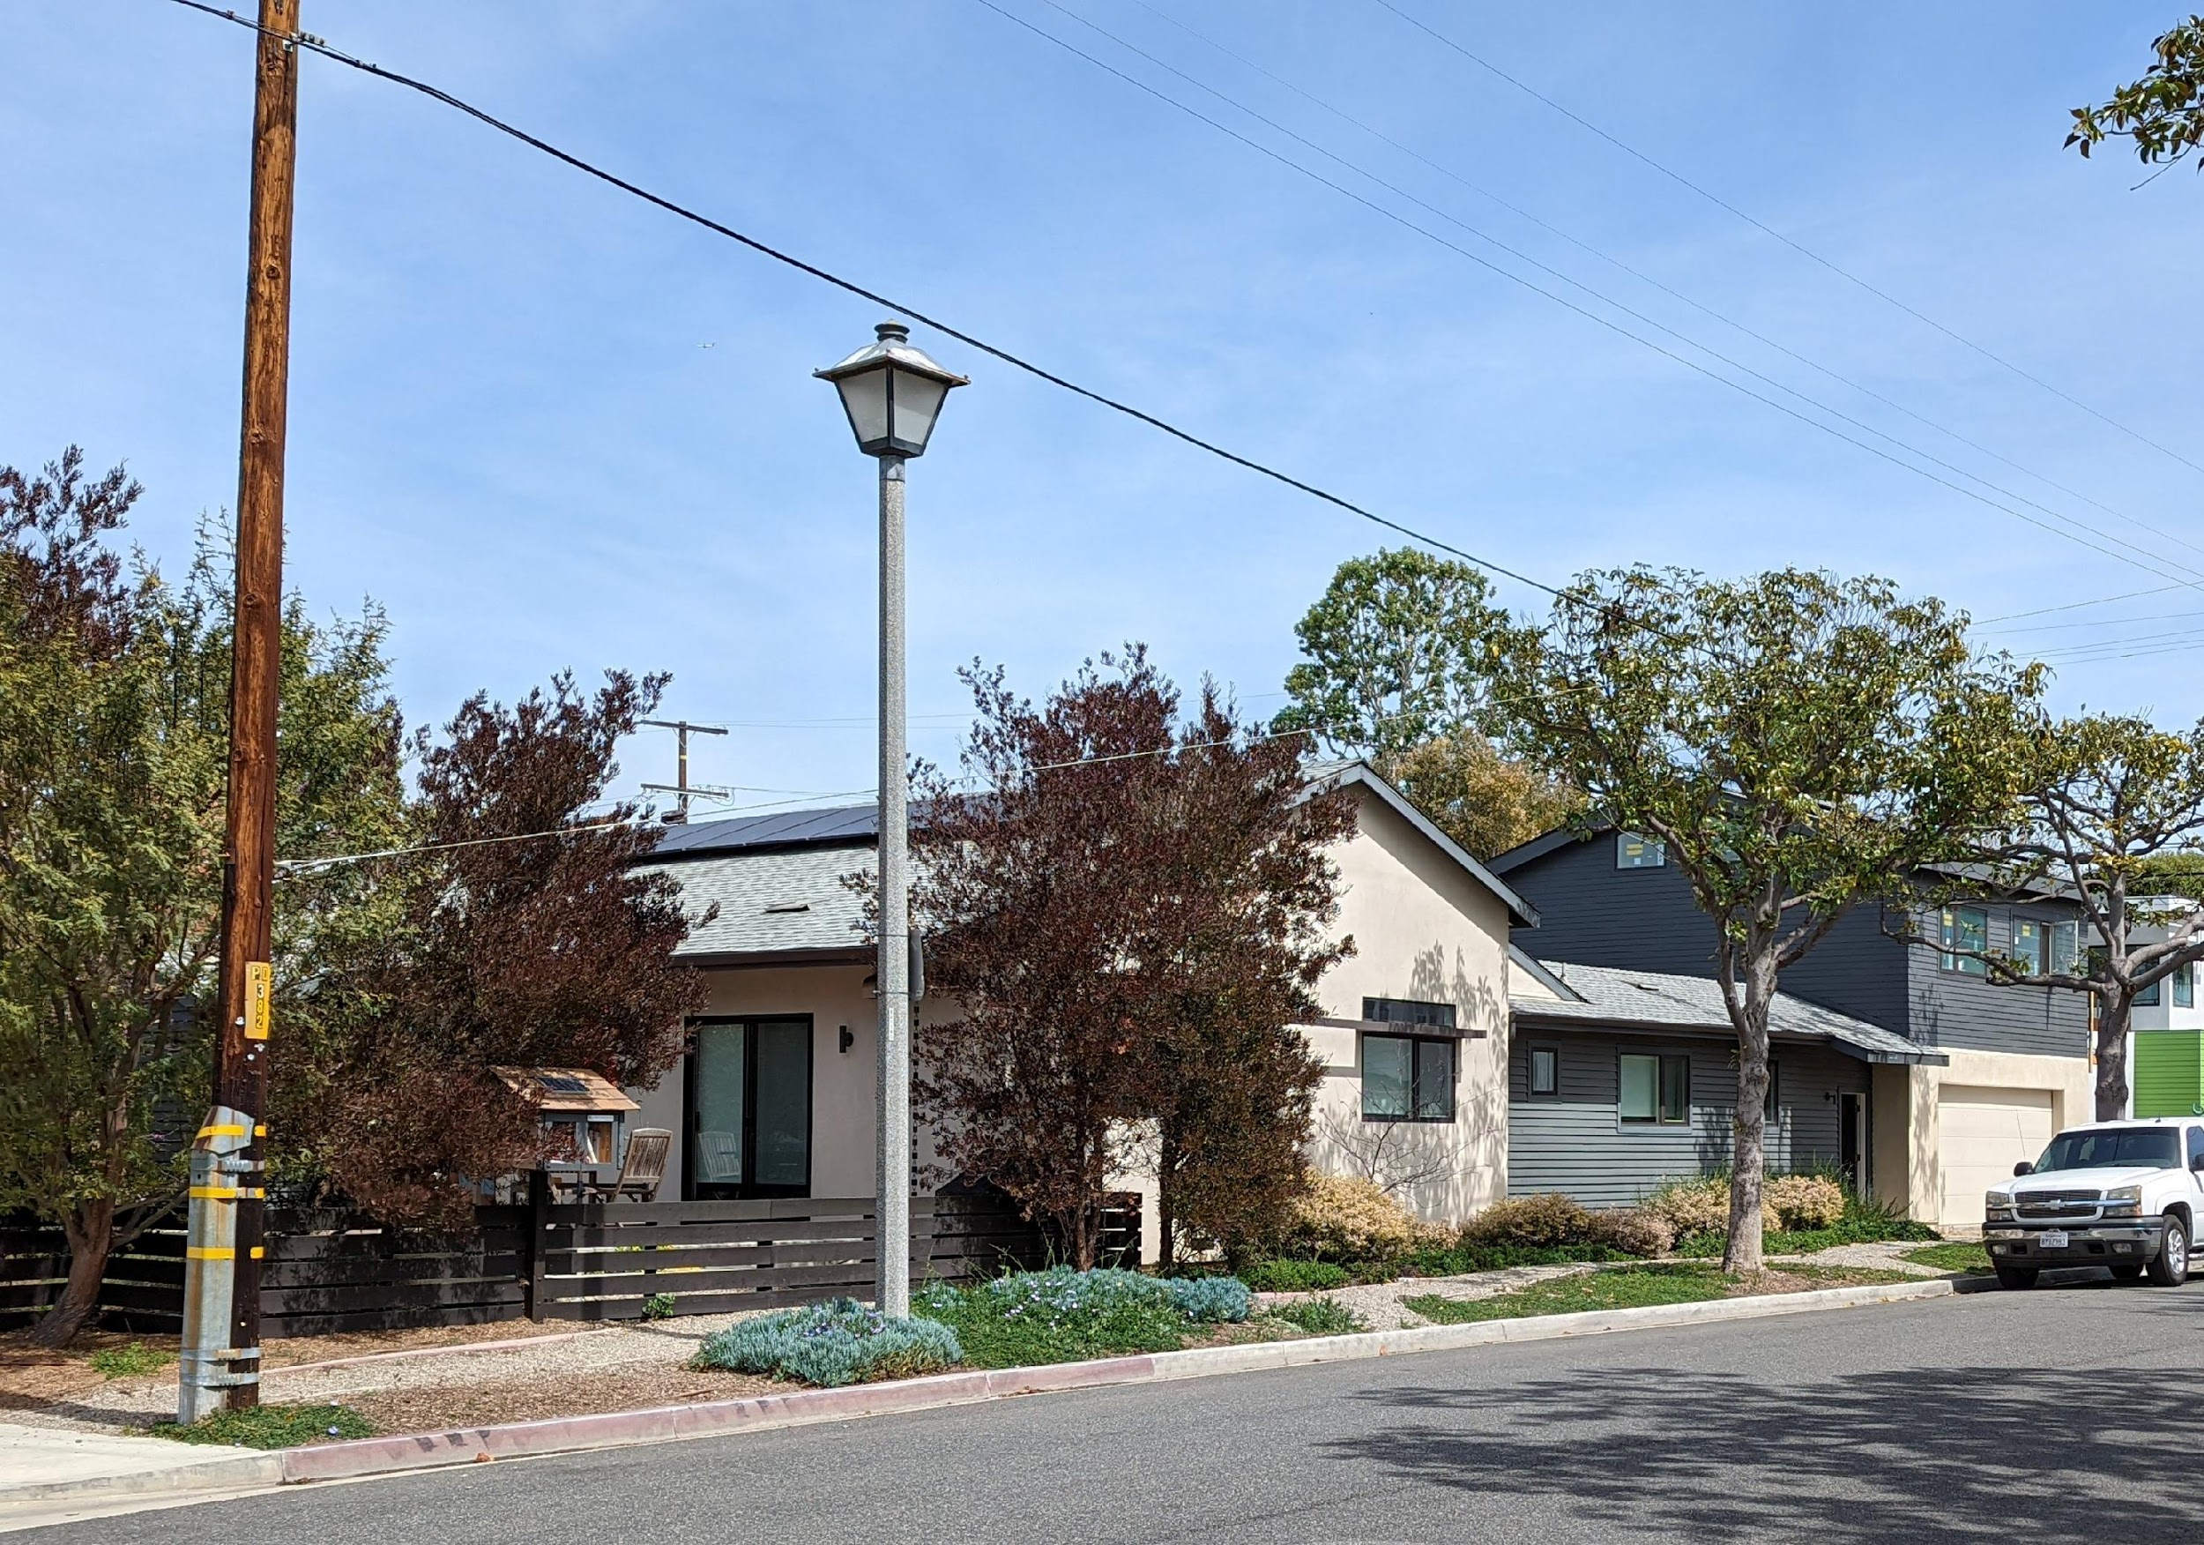

NICK BROWN
President
Build Smart Group
Long Beach

Slide 10





OUR TIME TOGETHER
Why Electric Homes are Important
Energy Code Requirements that Encourage Electrification
Lower GHG Emissions & Utility Costs, Incentives
Electric Ready, PV, Ventilation Requirements, VCHP & HPWH Compliance Credit
How to Model All-Electric
How All-Electric Performs vs Gas
Lessons from the Field
In EnergyPro & CBECC-Res
Compliance Comparisons in New Construction SF & MF, SF Alteration Projects
Smooth HERS Verification Process, Installation of HPWH, Electrical Panel Space
10

Slide 11
Why All-Electric Homes are Important

Slide 12




Slide 13
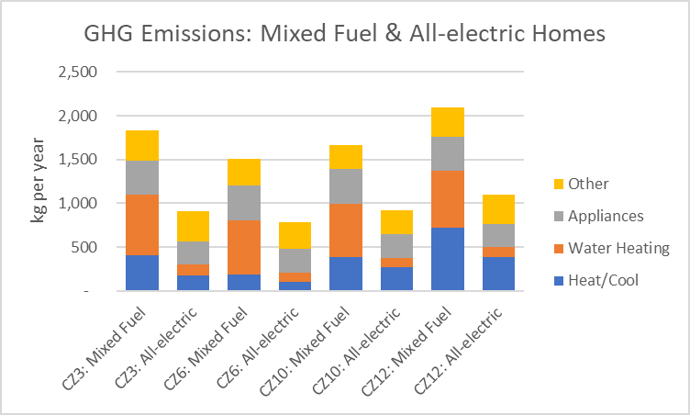
All-Electric Designs Reduce GHG Emissions ~50%
50%
48%
45%
47%
Source: CBECC-RES 2022 modeling of new 1751 sqft home with standard efficiency gas furnace/heat pump; gas tankless/heat pump water heater; gas & electric appliances

Slide 14
Utility Bills Better All-Electric
 | Standard PV |  |  | Add 1 PV Panel | % Savings Over Conventional with Standard PV
Conventional Gas/Electric | Gas $452 | Electric $169 | Total $621 | Total $607 | 0
Conventional Heat Pump | Gas $276 | Electric $444 | Total $720 | Total $583 | 9%
VCHP, High Efficiency, T24 | Gas $276 | Electric $306 | Total $582 | Total $445 | 28%
Modeling parameters:
Conventional Gas/Electric: 14.3 SEER2, 80 AFUE, ducts in attic
Conventional Heat Pump: 14.3 SEER2, 7.5 HSPF2, ducts in attic
VCHP High Efficiency Under Title 24: same as conventional HP with 5% cooling and 12% heating savings and ducts in conditioned space
Data based on study completed by Nick Brown of Build Smart Group in 2020 using CBECC-RES modeling software to compare energy costs for a 2-story home in Climate Zone 10 under SCE rates.
Notes:
An analysis of hourly energy use of a heat pump home in Climate Zone 10 (El Cajon) produced the above results. This analysis reflects the complicated nature of the interaction between PV panels and the electric usage in a home with both electricity and gas, with Time of Use electric rates applied to hourly energy usage. The “Standard PV” results are with the prescriptive standard 3.26 kW PV system (~10 panels) for this size house in this climate zone. The Central Heat Pump has slightly higher utility costs in this scenario, because the PV system is right-sized for the mixed fuel home and insufficient to offset electric usage with a Heat Pump. As soon as just one PV panel is added (3.58 kW or ~11 panels) at an extra cost of roughly $600 when the home is built, utility costs drop $40 below the conventional gas/electric split system. In the high performance Variable Capacity Heat Pump modeling scenario in the same house, utility costs are $40 lower than conventional with the same PV system and $175 (28%) lower once one additional PV panel is added (a 4 year payback). This investment will pay off every year for the estimated 15-20-year lifespan of the PV system and heat pump.
The homes equipped with the heat pump have 18-25% lower carbon dioxide emissions than the home with the traditional gas furnace at 1.6-1.8 tons of CO₂ versus 2.2 tons.
The VCHP credit likely under-estimates energy savings from heat pump heating and cooling, as it is based on only a portion of measured savings at the Central Valley Research Homes project.
More information regarding projected savings can be found in the participant workbook.

Slide 15
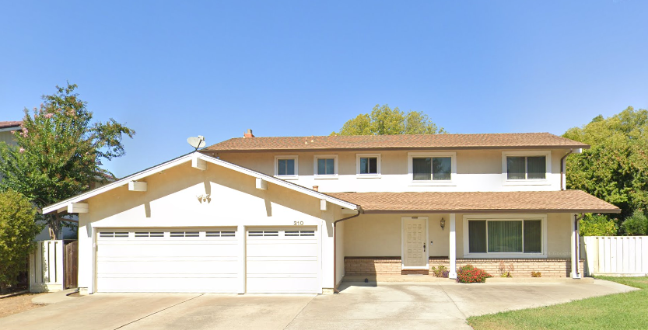
Solar & Battery Are Key to Electrification & Decarbonization
Southern California Example: CZ 6
Modeled energy usage for 2-story existing/remodeled house in CZ6 (Coastal Los Angeles) under NEM3 with current SCE/SCG rates as of August 2024. Battery modeled using Basic control.

Slide 16
Solar & Battery Are Key to Electrification & Decarbonization
Northern California Example: CZ 12
Modeled energy usage for existing/remodeled 2-story house in CZ12 (Sacramento) under NEM3 with current PG&E rates as of August 2024. Battery modeled using Basic control.

Slide 17






California Has Strong Climate Commitment
  40% GHG reduction by 2030
  Electric sector:
  60% renewables
  by 2030
  100% carbon-free by 2045
  Carbon neutrality by 2045
  26% GHG reduction by 2025
  1.5 deg C goal
SB 32 (2016)
SB 100 (2018)
Gov. Exec Order (2018)
PARIS (2016)
  40% GHG reductions in buildings by 2030
  $200M/4yrs incentives for building decarb
  TECH/BUILD
  No ICE Car Sales by 2035
  Defense Production Act
  Accelerate Clean Energy technologies
  $369b Inflation Reduction Act
  40% GHG reductions by 2030
AB 3232
SB 1477
Gov. Exec Order (2020)
Executive Order (2022)
U.S. Congress (2022)
Notes:
Strong climate laws passed recently
100% carbon-free electricity by 2045
Could add possible Biden bump of $2 trillion and nationwide 100% renewable electricity by 2035

Slide 18
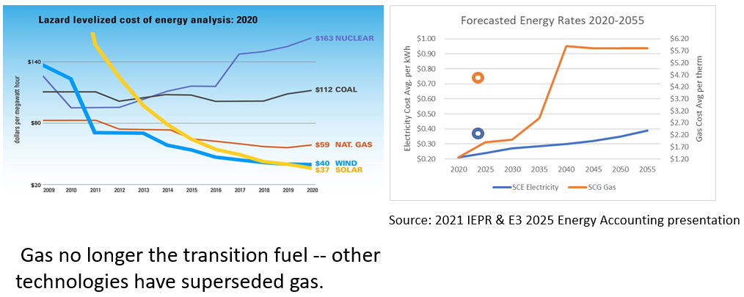
It Works and is Less Expensive

Slide 19
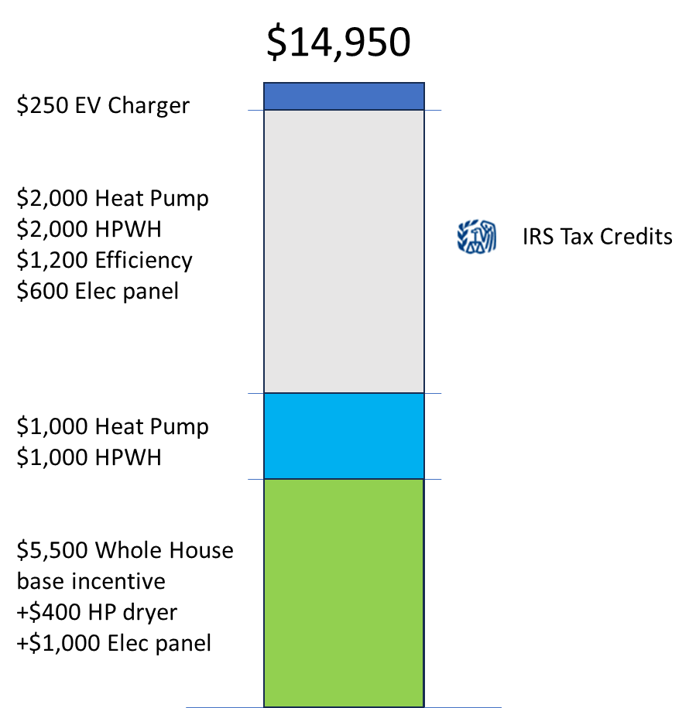



Incentives Add Up
All-Electric Retrofit
Available to All Income Levels

Slide 20
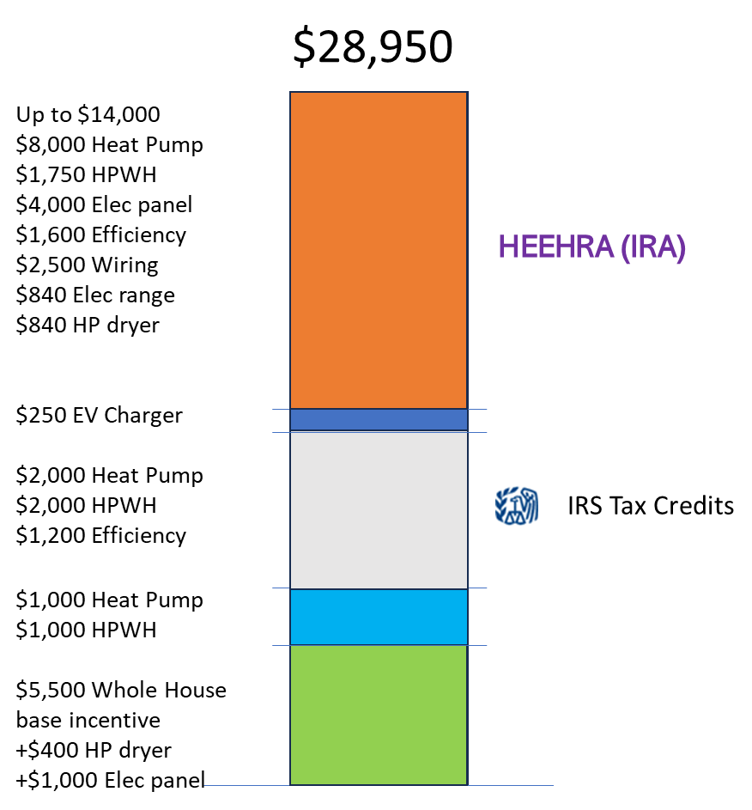
Incentives Add Up
All-Electric Retrofit
Low-income
<80% median income

Slide 21
Energy Code Requirements that Encourage Electrification

Slide 22
Single-family Prescriptive Requirements for Heat Pumps
Heat Pump Water Heater
Heat Pump Space Conditioning

Slide 23
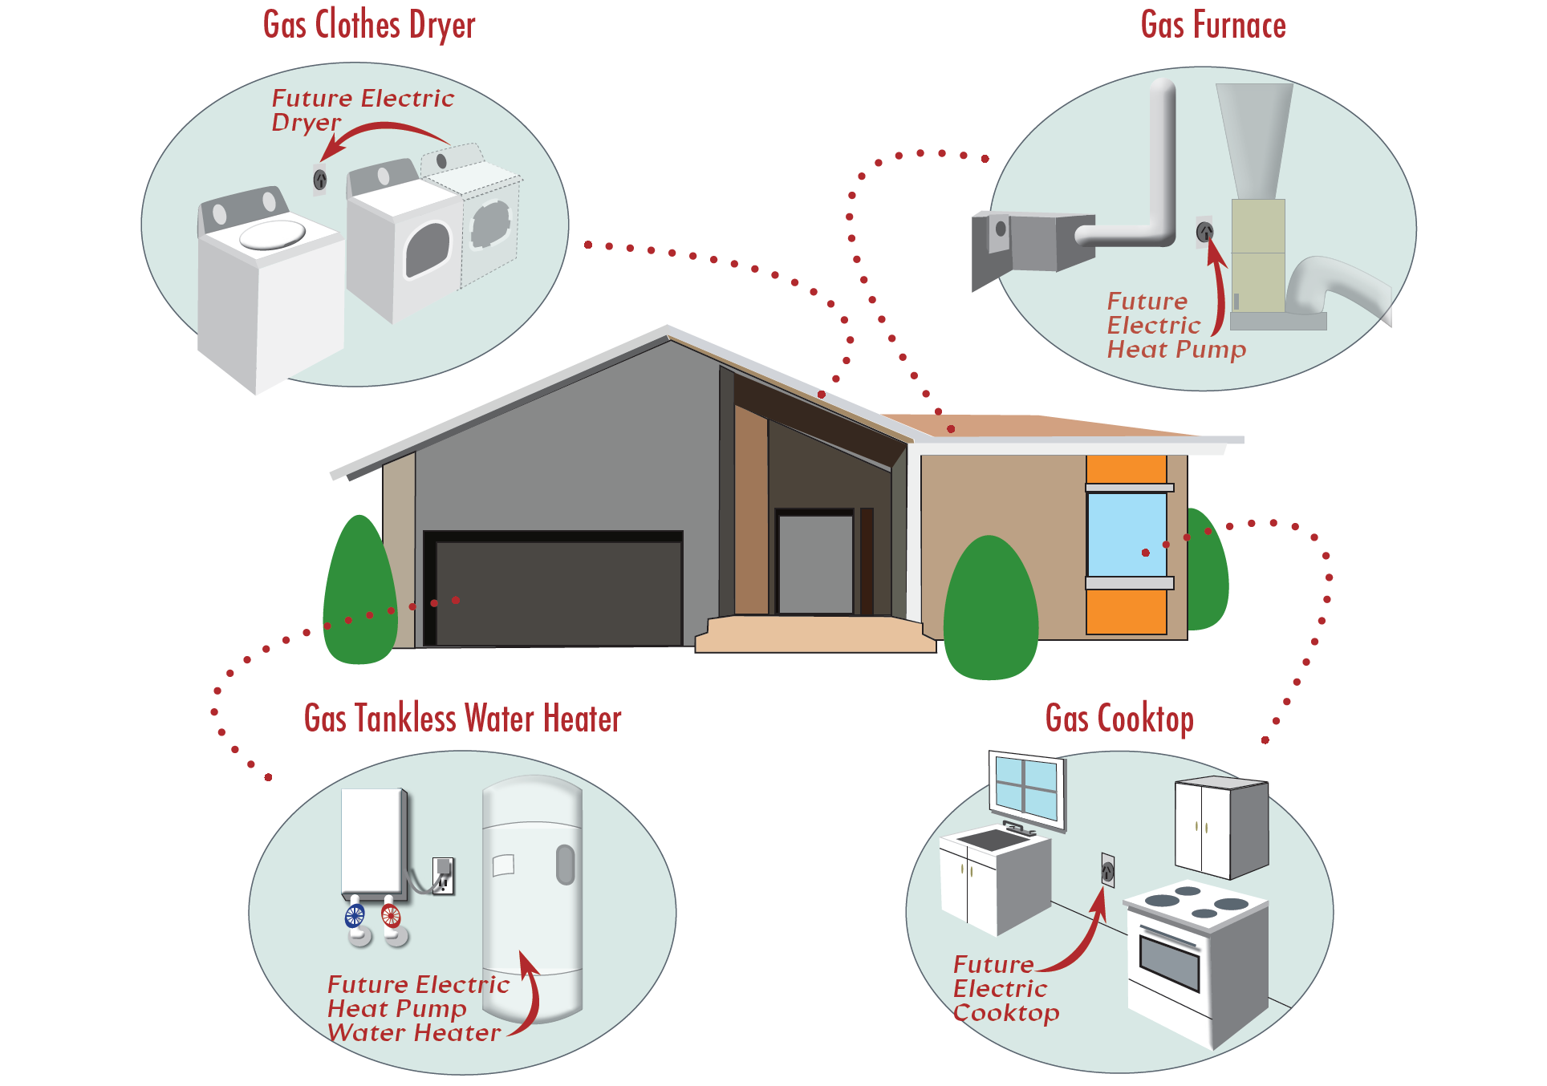
Electric Retrofit Ready

Slide 24

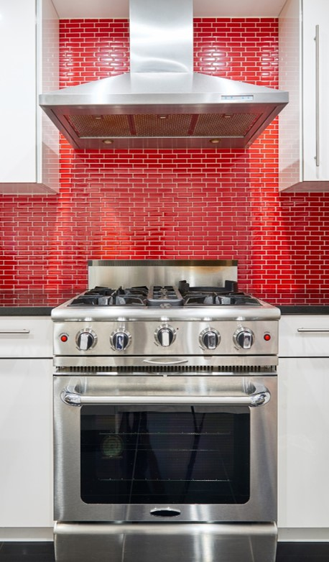
Range Hoods
§150.0(o)1.G.iii
New Standards Introduced for 2022
Must meet requirements of Table 150.0-G by EITHER:
      Capture efficiency (CE) OR
      Air flow (cfm)
Higher air flow and CE required for gas ranges.
In all cases, max 3.0 sones applies via ASHRAE 62.2, Section 7.2
Dwelling Unit Floor Area (ft²) | Hood Over Electric Range | Hood Over Natural Gas Range
>1500 | 50% CE or 110 cfm | 70% CE or 180 cfm
>1000 - 1500 | 50% CE or 110 cfm | 80% CE or 250 cfm
750 - 1000 | 55% CE or 130 cfm | 85% CE or 280 cfm
<750 | 65% CE or 160 cfm | 85% CE or 280 cfm

Slide 25




Evolving Building Energy Efficiency Ratings
For Residential Construction
Energy Code | New Construction | Additions | Alterations
2016 | TDV | TDV | TDV
Time Dependent Valuation (TDV):
“TDV Energy” is the time varying energy used by the building to provide space conditioning, water heating and specified building lighting. It accounts for the energy used at the building site and consumed in producing and delivering energy to a site, including, but not limited to, power generation, transmission and distribution losses.

Slide 26
Evolving Building Energy Efficiency Ratings
For Residential Construction
Energy Code | New Construction | Additions | Alterations
2016 | TDV | TDV | TDV
2019 | EDRe, EDRt | TDV | TDV
t = “total” EDR metric
(also factors in PV
and flexibility)
e = “efficiency”
EDR metric
Time Dependent Valuation (TDV):
“TDV Energy” is the time varying energy used by the building to provide space conditioning, water heating and specified building lighting. It accounts for the energy used at the building site and consumed in producing and delivering energy to a site, including, but not limited to, power generation, transmission and distribution losses.
Energy Design Rating (EDR):
An alternate way to express the energy performance of a home using a scoring system where 100 represents the energy performance of a reference design building meeting the envelope requirements of the 2006 International Energy Conservation Code (IECC). A score of 0 represents the energy consumption of a building that has zero net energy consumption. The lower the score, the better.

Slide 27
Evolving Building Energy Efficiency Ratings
For Residential Construction
Energy Code | New Construction | Additions | Alterations
2016 | TDV | TDV | TDV
2019 | EDRe, EDRt | TDV | TDV
2022 | EDRs, EDRe, EDRt | TDV | TDV
New for 2022
s = “source”
EDR metric
Enables measure of
emissions in some
form
Time Dependent Valuation (TDV):
“TDV Energy” is the time varying energy used by the building to provide space conditioning, water heating and specified building lighting. It accounts for the energy used at the building site and consumed in producing and delivering energy to a site, including, but not limited to, power generation, transmission and distribution losses.
Energy Design Rating (EDR):
An alternate way to express the energy performance of a home using a scoring system where 100 represents the energy performance of a reference design building meeting the envelope requirements of the 2006 International Energy Conservation Code (IECC). A score of 0 represents the energy consumption of a building that has zero net energy consumption. The lower the score, the better.
Source Energy Design Rating (EDRs):
A separate EDR metric based on “hourly source energy,” which establishes a "carbon-proxy" analysis of the building in kBTU/sf-yr units to support decarbonization and electrification policy goals.

Slide 28
EDR as a Compliance Metric (2022)
Source EDR
a score representing the building energy efficiency expressed in terms of an hourly source carbon
based metric
Efficiency EDR
a score representing the building energy efficiency expressed in terms of a
TDV energy
based metric
Total EDR
a score representing the building’s Total TDV
while also factoring in
PV + Flexibility
PS22-019
Includes energy used by:
Envelope
IAQ
HVAC
DHW
Photovoltaics
Batteries
Unregulated loads
Includes energy used by:
Envelope
IAQ
HVAC
DHW
Unregulated loads
Includes energy used by:
Efficiency measures
Photovoltaics
Batteries
Precooling
A building complies ONLY if all three compliance scores are met (each Proposed Design score is lower or equal to Standard Design score)

Slide 29
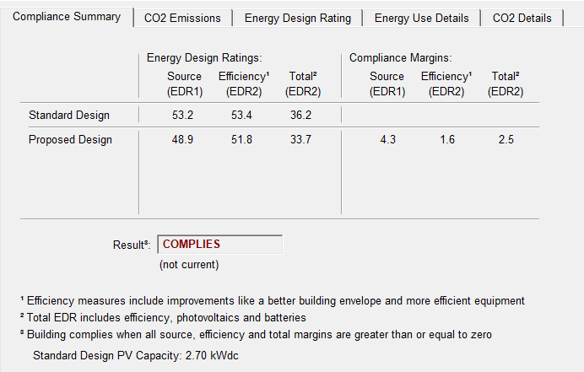

EDR as a Compliance Metric (2022)
All three ratings show
better (lower) rating for
Proposed than Standard
All three compliance
margins (deltas) show zero
or positive values

Slide 30
Compliance Benefit of Heat Pumps & Heat Pump Water Heaters
Heat Pump:
    Standard Central: 5% Efficiency EDR & 18% Source EDR
  Variable Capacity Heat Pump (VCHP): 17% Efficiency EDR & 24% Source EDR
Heat Pump Water Heater:
  Generic: 8% Efficiency EDR & 8% Source EDR
  NEEA Tier III: 10% Efficiency EDR & 10% Source EDR
  Specific Make/Model: 17% Efficiency EDR & 30% Source EDR

Slide 31
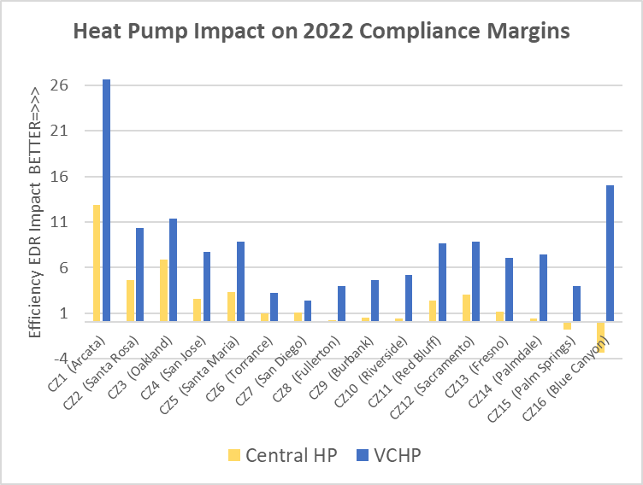
HVAC Heat Pumps Perform Well for Compliance
Average
Compliance
Impact:
Efficiency EDR:
  Central HP 2.3 (5%)
  VCHP 8.5 (17%)
Source EDR:
  Central HP 8.2 (18%)
  VCHP 10.5 (24%)

Slide 32
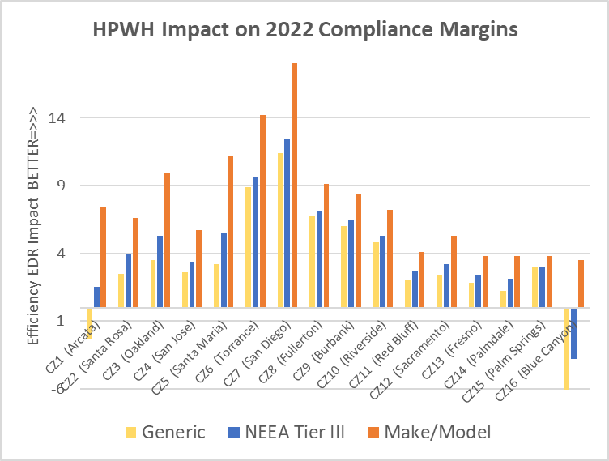
NEEA HPWHs Model Better than Gas
Average
Compliance
Impact:
Efficiency EDR:
  Generic 3.2 (8%)
  NEEA Tier III 4.4 (10%)
  Make/Model Specific 7.7 (17%)
Source EDR:
  Generic 10.0 (8%)
  NEEA Tier III 10.6 (10%)
  Make/Model Specific 11.6 (30%)

Slide 33

PV Required on all New SF and MF Buildings
§150.1(c)14
Table 150.1-C: CFA and Dwelling Unit
Adjustment Factors
Prescriptive requirement for PV system size is based on:
  Size of home (conditioned square footage)
  Solar Access Roof Area (SARA)
Expressed as a kW (DC Rating)
DC Rating = (CFA x A) / 1000 + B
  CFA = Conditioned floor area
  A = CFA adjustment factor from
  Table 150.1-C
  B = Dwelling unit adjustment factor from Table 150.1-C
Climate Zone | A – CFA | B – Dwelling Units
1 | 0.793 | 1.27
2 | 0.621 | 1.22
3 | 0.628 | 1.12
4 | 0.586 | 1.21
5 | 0.585 | 1.06
6 | 0.594 | 1.23
7 | 0.572 | 1.15
8 | 0.586 | 1.37
9 | 0.613 | 1.36
10 | 0.627 | 1.41
11 | 0.836 | 1.44
12 | 0.613 | 1.40
13 | 0.894 | 1.51
14 | 0.741 | 1.26
15 | 1.56 | 1.47
16 | 0.59 | 1.22

Slide 34
Variable Capacity Heat Pump (VCHP)
Modulate heating & cooling to match load
  Maintains comfort continuously
Both indoor and outdoor units are quiet
Equipment has long lifespan
Can be 60%+ more efficient than typical equipment (SEER rating)
The 2022 CA Energy Code (Title 24, Part 6) offers compliance credit for VCHPs
Soon the software will extend the VCHP credit to a wider variety of ducted units

Slide 35
How to Model All-Electric

Slide 36
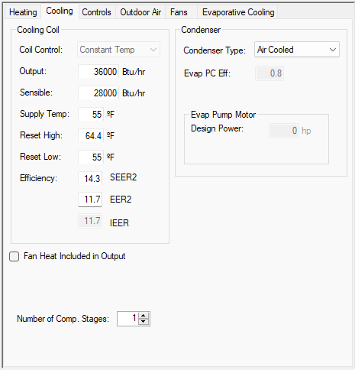
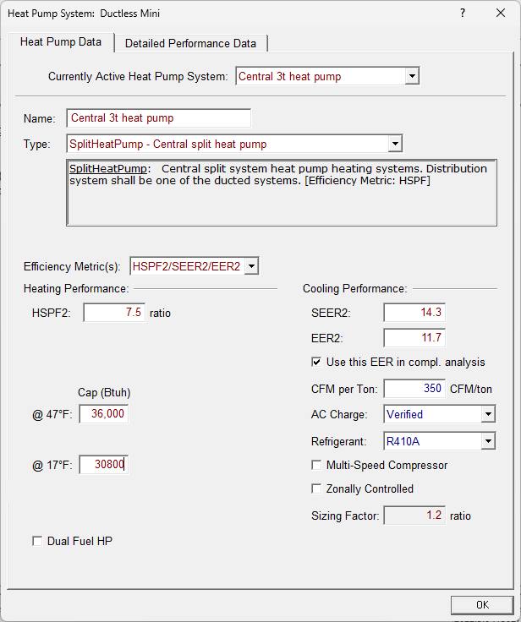
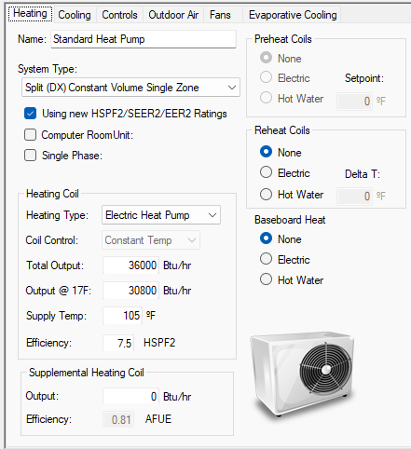
Specifying a Heat Pump is Simple

Slide 37
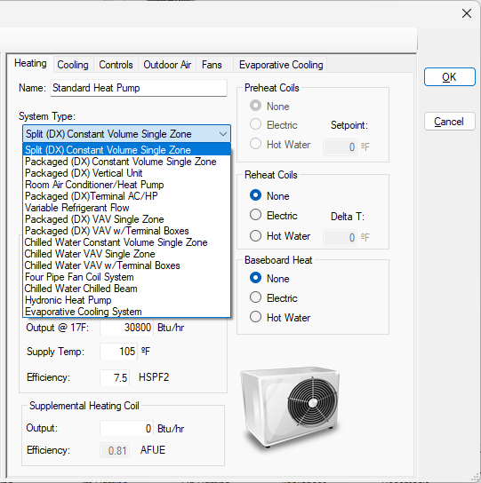
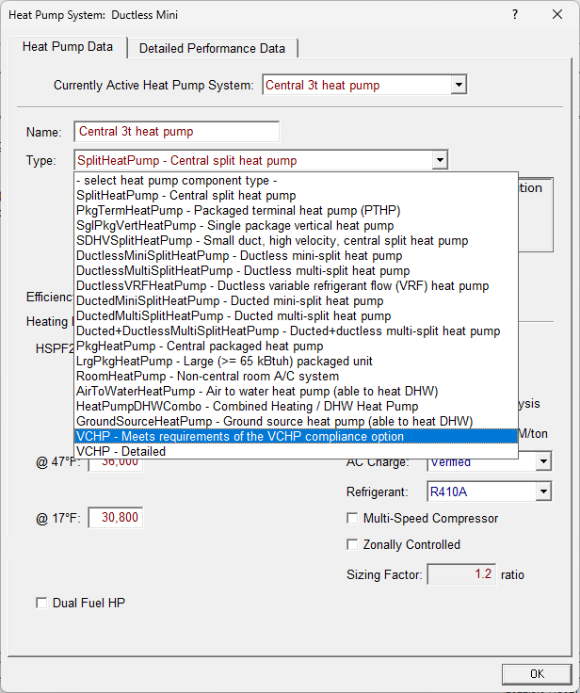
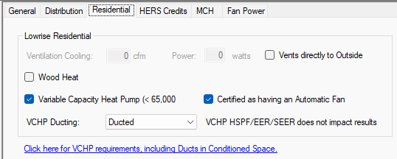
Other Configurations Supported

Slide 38
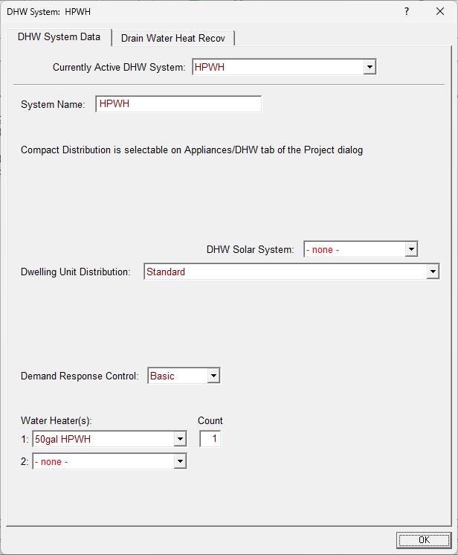
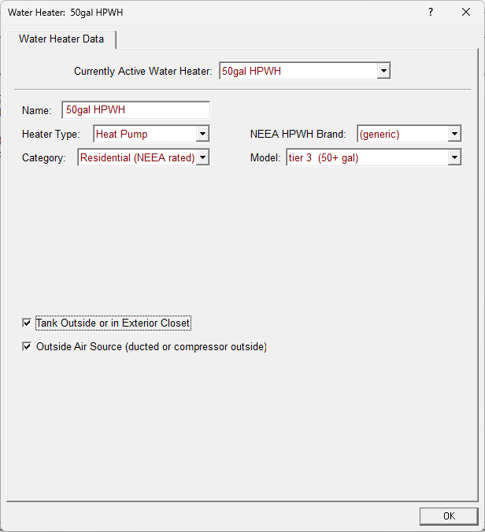
Specifying a Heat Pump Water Heater - CBECC-Res

Slide 39
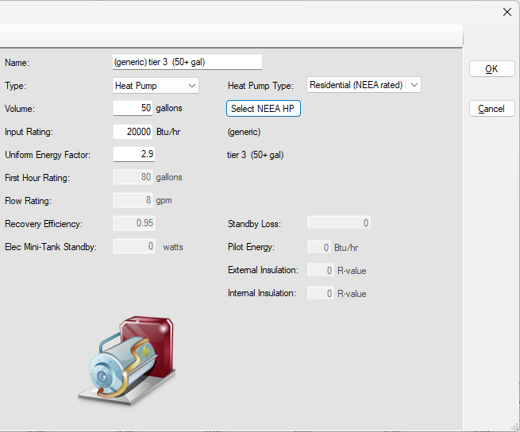
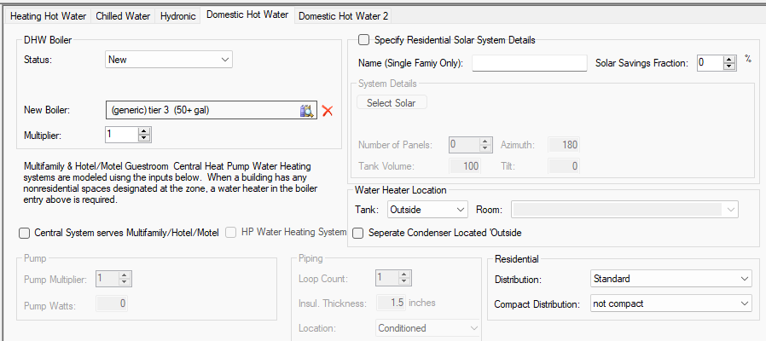
Specifying a Heat Pump Water Heater – Energy Pro

Slide 40
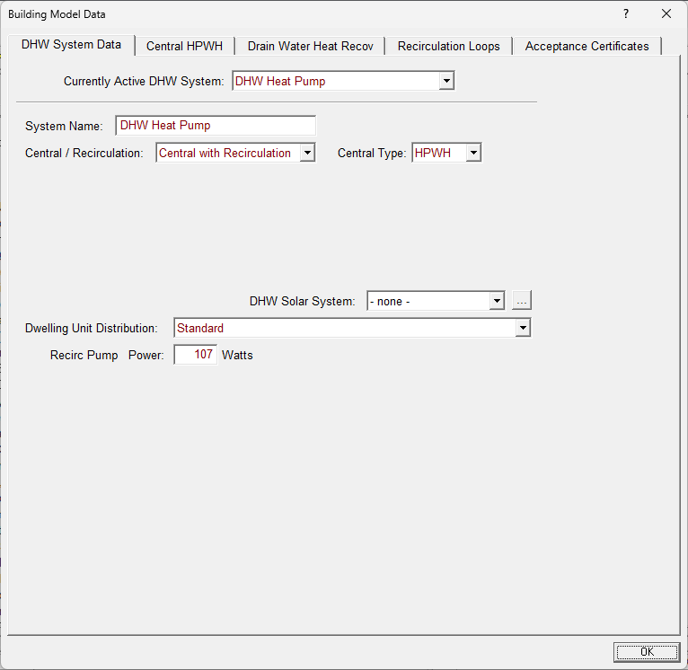
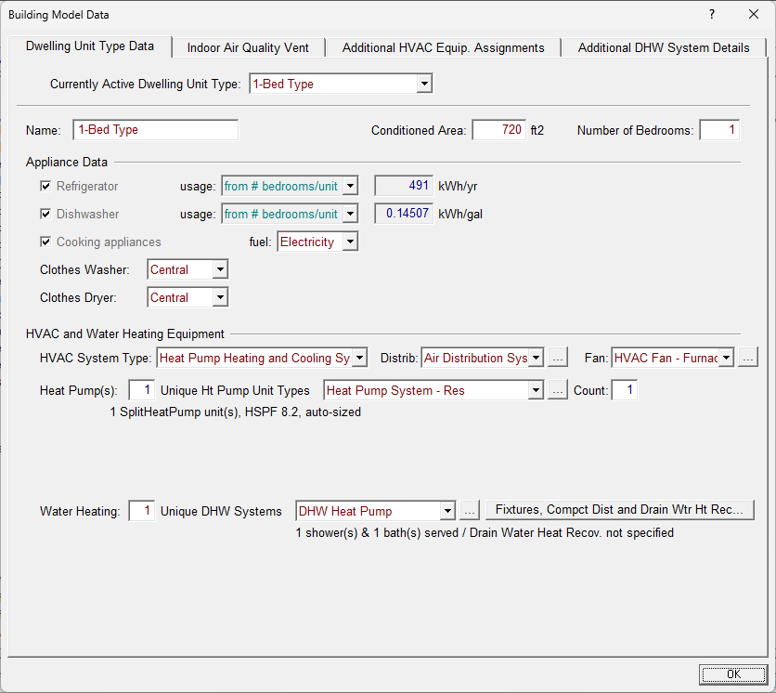
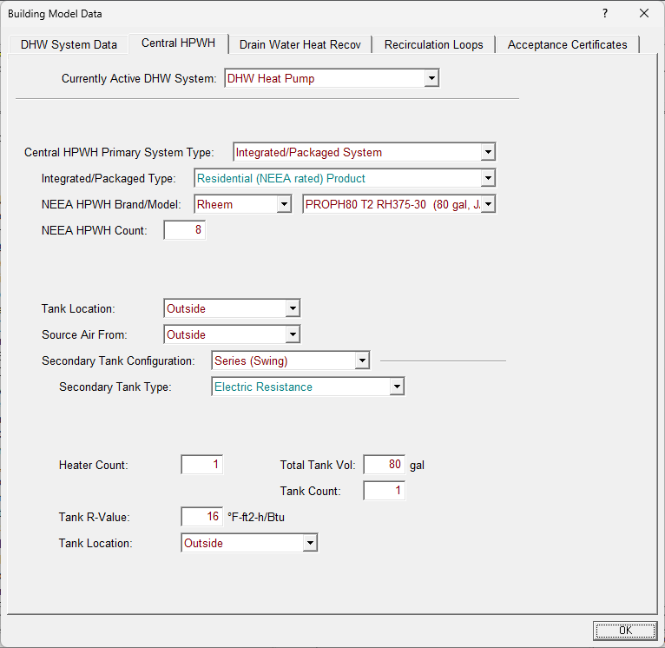
Specifying a Heat Pump Water Heater in Multifamily-CBECC-Res

Slide 41
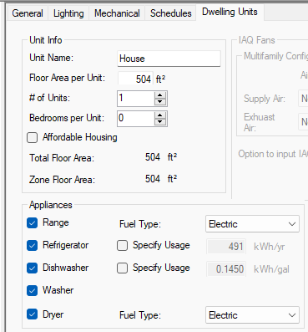
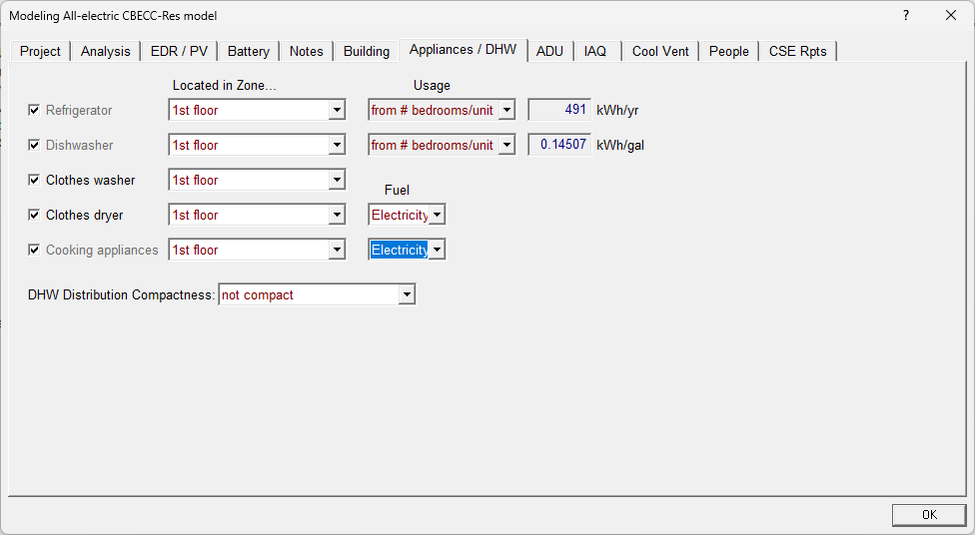
Specifying Appliances

Slide 42
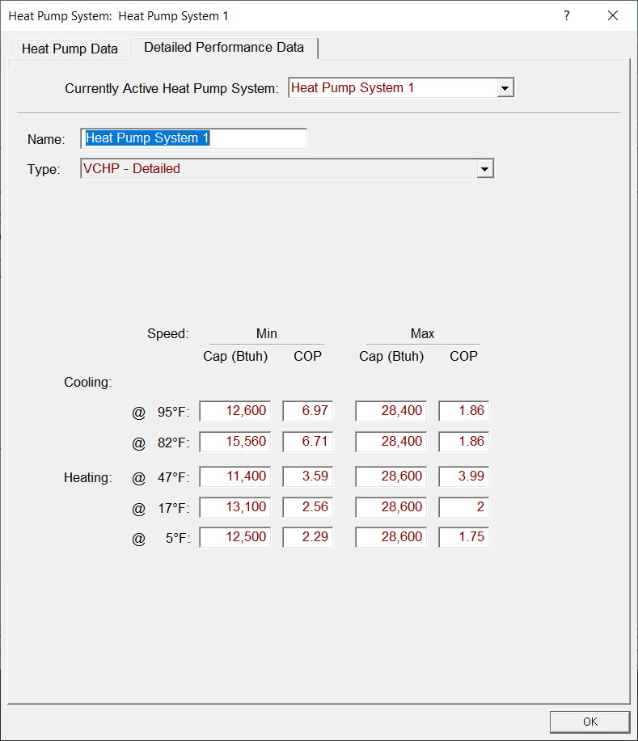
Energy Code Encourages All-Electric More than Ever
Compliance credit soon possible with advanced heat pumps (Detailed VCHP credit)
  Extends VCHP level compliance credit to ducted minisplits
  Not yet active in software – still in beta testing
Notes:
Note on High-rise Residential

Slide 43
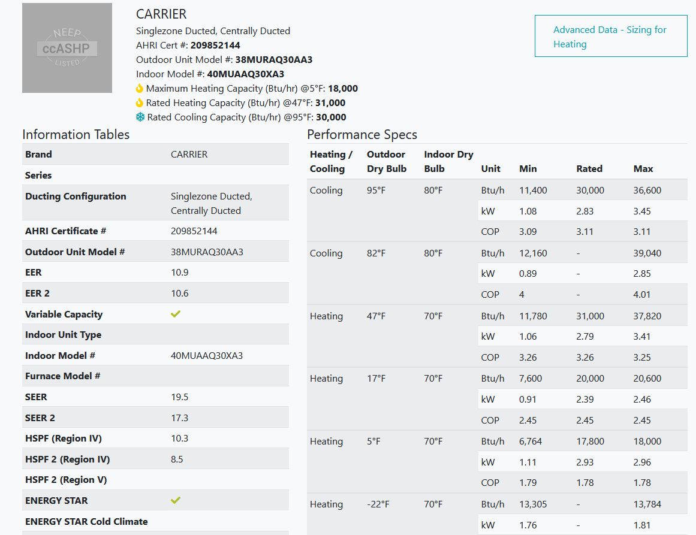
Detailed VCHP
NEEP website has detailed performance specs
Allows for Ducted Minisplits to help compliance
Eliminates requirement that all VCHPs be low-static models
Notes:
Note on High-rise Residential

Slide 44
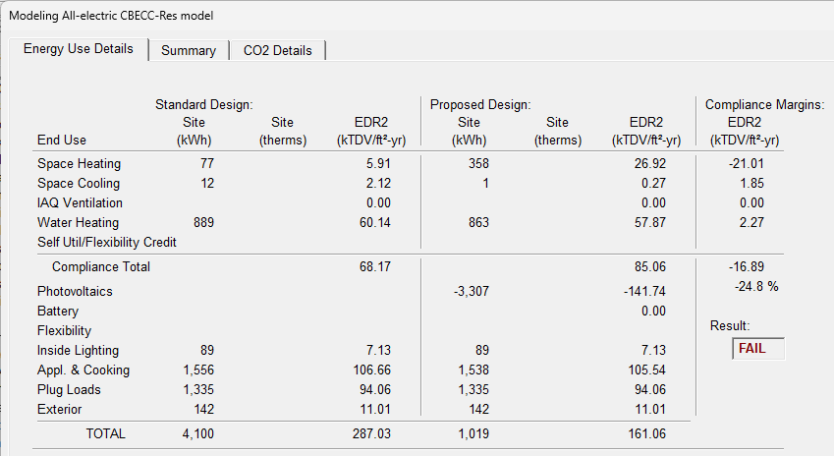
Using the Software Output
Garage to ADU Conversion, 410 sqft, CZ5 (e.g., San Luis Obispo) with 2 kW PV array

Slide 45
How All-Electric Performs versus Gas

Slide 46
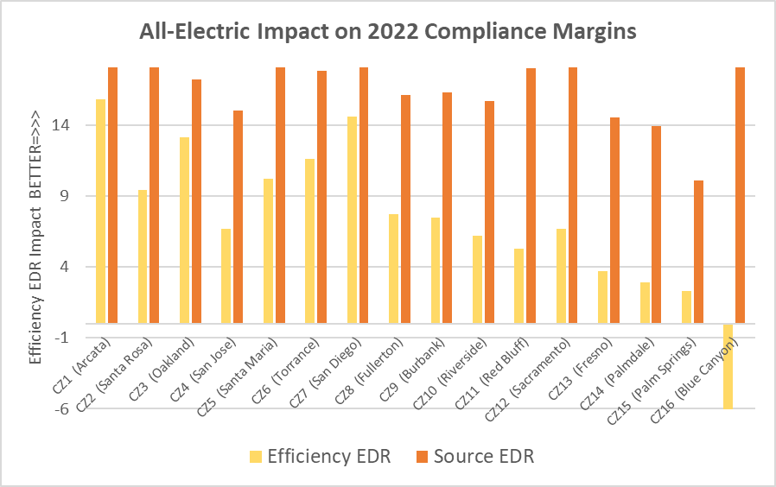
All-Electric Makes Compliance Easier Everywhere
Average
Compliance
Impact:
Efficiency EDR: 7.3 (16%)
Source EDR: 19.1 (50%)

Slide 47
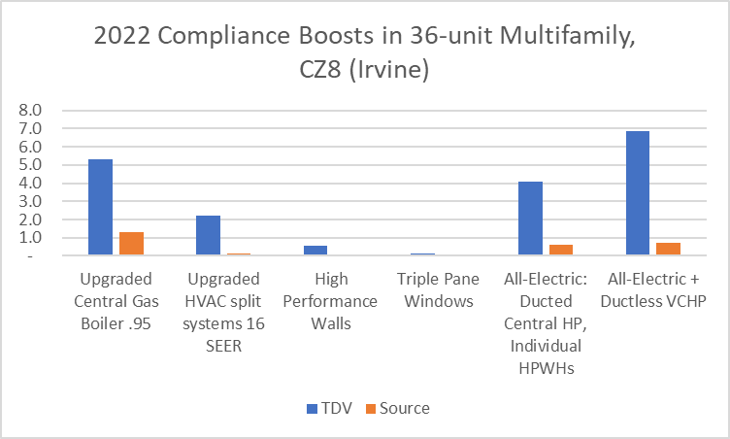
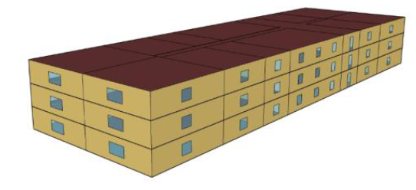
Easier Code Compliance – Multifamily Edition
In a 36-unit Multifamily building in Climate Zone 8 (Irvine):
  All-electric with VCHP helps energy code compliance most
  Only upgraded central boiler with solar thermal system provides bigger boost

Slide 48
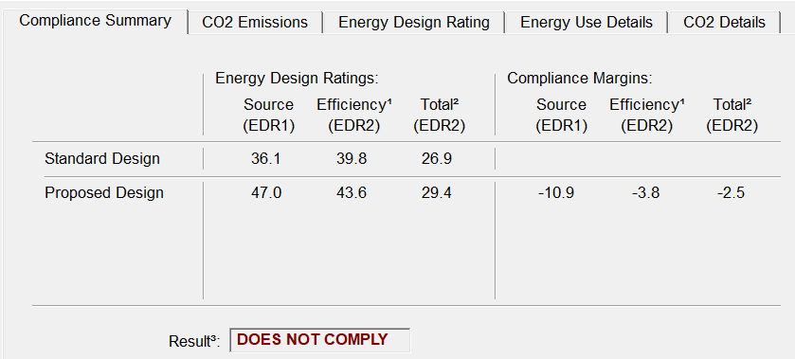
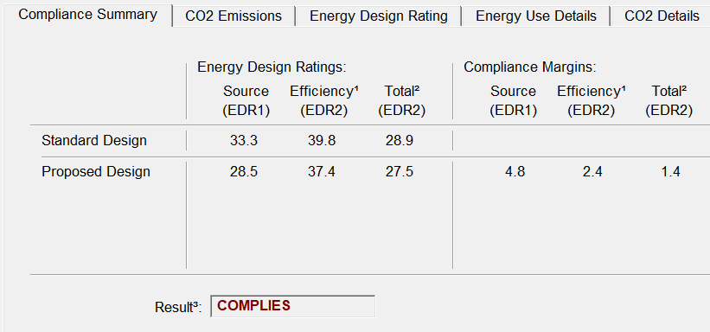
Gas vs Electric Comparison 2022 Code
Dual Fuel
All Electric

Slide 49
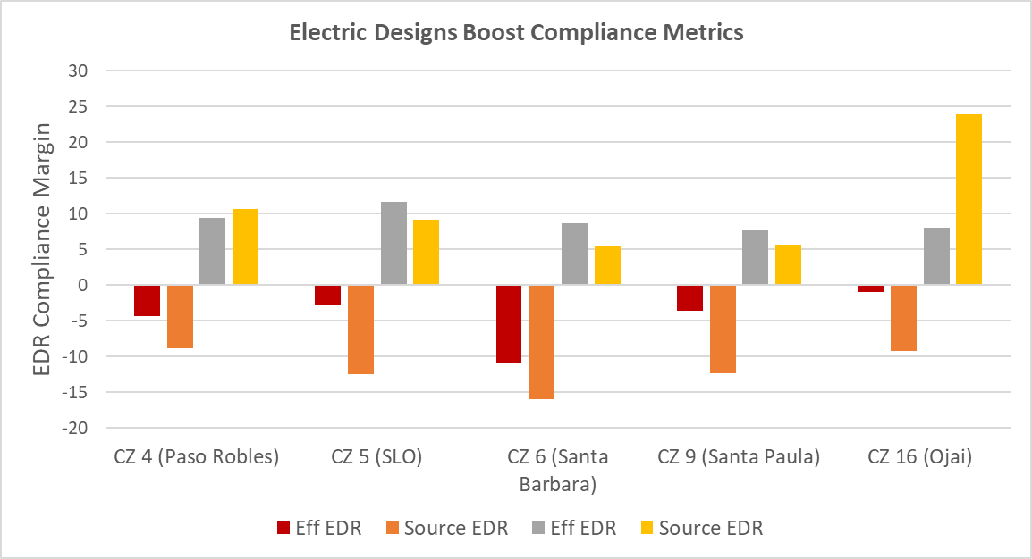
Case Study: New Single Family Home
ELECTRIC
ELECTRIC
ELECTRIC
ELECTRIC
ELECTRIC
GAS
GAS
GAS
GAS
GAS
2,100 sqft new home with code minimum gas systems and code minimum electric systems

Slide 50
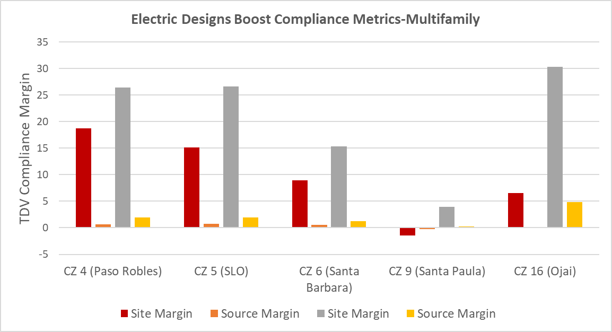
Case Study: New Multifamily 8-unit Building
ELECTRIC
ELECTRIC
ELECTRIC
GAS
GAS
ELECTRIC
GAS
GAS
ELECTRIC
GAS
8-unit new multifamily building with code minimum gas systems and code minimum electric systems

Slide 51
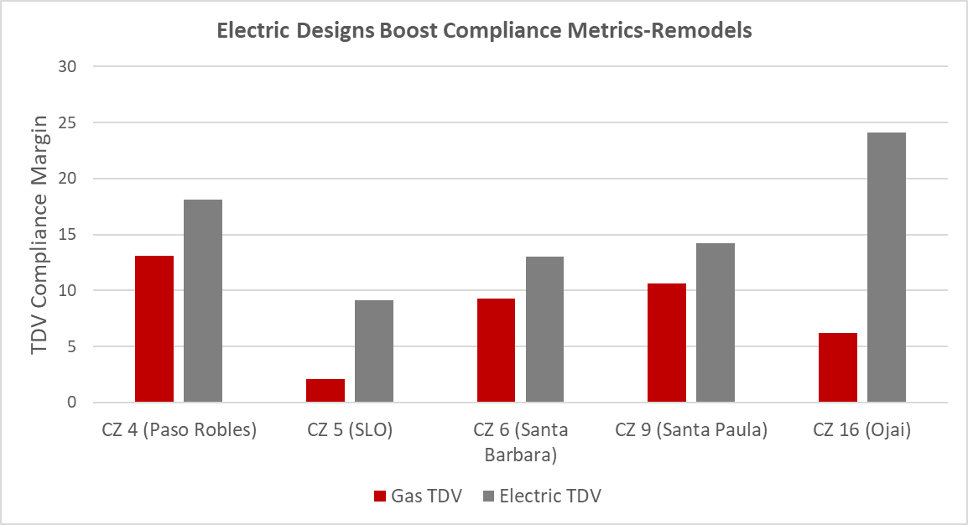
Case Study: Single Family Addition
940 sf home with 588 sf addition with code minimum gas systems and code minimum electric systems

Slide 52
Lessons from the Field

Slide 53
All-Electric & HERS Verifications
How Heat Pumps are Different from Gas Furnaces
HERS verified heat pump capacity
VCHP HERS verification
Each outdoor unit can link to multiple indoor units, ducted and ductless

Slide 54

HERS registry
CF1R
Incomplete HVAC information
Architect sends plans back for revisions
HVAC units installed are different
Final Inspection
HERS verifications

Slide 55
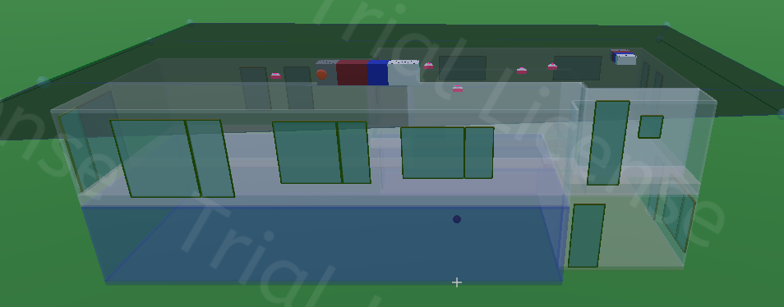
Specifying VCHPs Without Boomeranging
Size them right
Get # of systems right
Get ducted/ductless right
Get SEER2/EER2/HSPF2 right
Energy Pro load calcs; Kwik Model; what about CBECC-Res?
Force architect to talk to HVAC installer
Force architect to talk to building owner
Code minimum or energy consultant specifies equipment

Slide 56
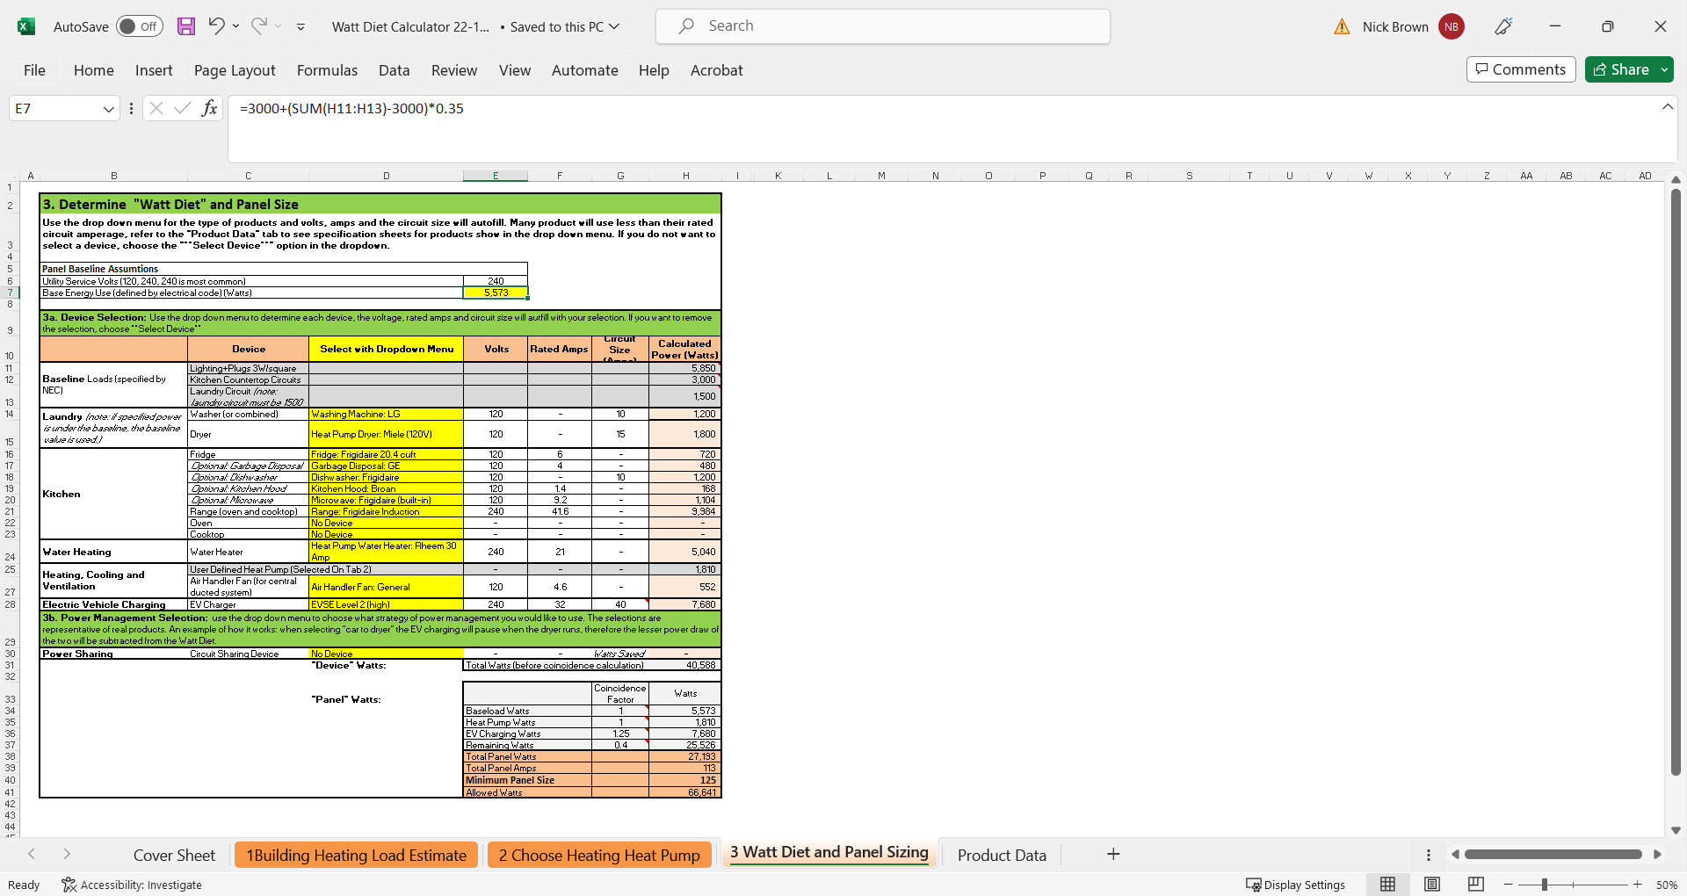
Watt Diet
Helps You Fit into Your Panel
Establish your base load (e.g., lighting and plugs often on)
Enter your other loads and power requirements from tech sheets
Watt Diet calculates the panel you need
Allows for circuit sharing
Watt Diet Calculator

Slide 57
Watt Diet Example: 125 amps

Slide 58
Panel Upgrades
How Your Electrician Thinks
How to Manage Your Electrician
Electrical Code governs panel sizing based on all the loads in your home
Exceed the rated capacity and you’ll need an upgrade
Better to have too much power
Show them your monthly electric usage for the past 12 months
Give them the power requirements of your new electric systems
Ask them to show you their calculations
Think of the future: EV charging, PV panels, batteries, pool equipment and consider upgrading your panel

Slide 59
Panel Upgrades
Why You Have More Power than You Might Think
How to Make it Work Without a Panel Upgrade
If you already have A/C, a Heat Pump provides heating with no extra power
A Heat Pump Water Heater and Heat Pump Dryer can get by with only the power of a lighting circuit (120V 15 amps)
Existing homes have more power allotted to lighting that can be used elsewhere
Circuit sharing devices allow for loads never to run together (such as EV charger and Stove)
      Combined Washer-Dryer
      Channing Copper Induction Range only 120V, 15 amps instead of 240V, 50 amps
      EV chargers at 20-30 amps, not 50 amps

Slide 60
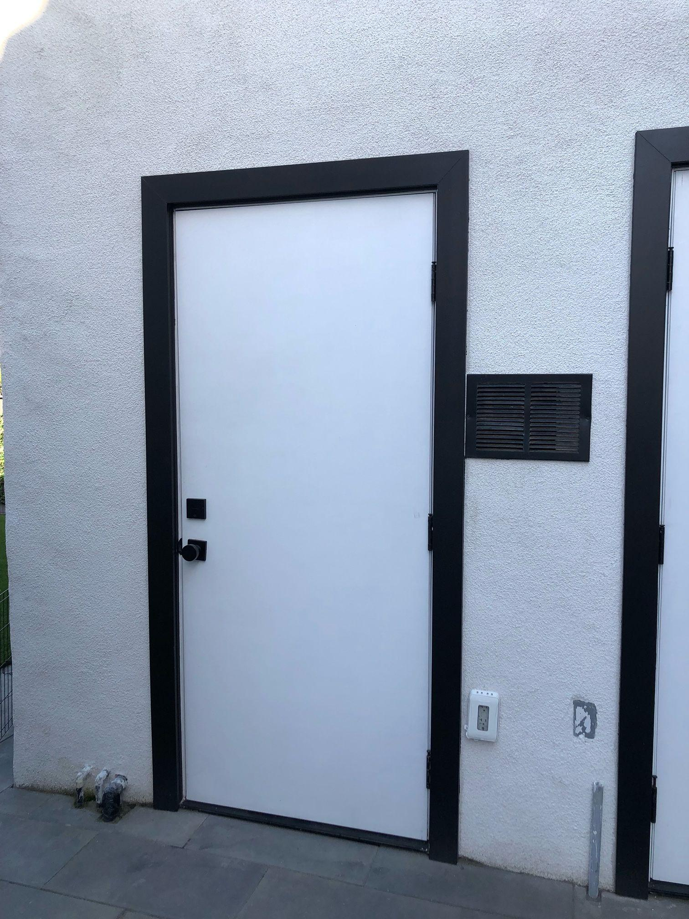
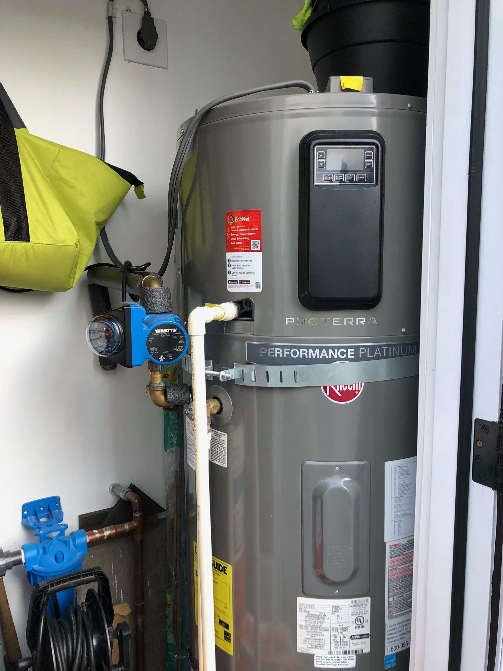
HPWH Dos and Don’ts
DO Provide air flow
DO Upsize tank size
DON’T leave high flow fixtures
DON’T allow recirc pump to use all the hot water

Slide 61
All-Electric Retrofits
Heat Pump: Locate Outdoor Unit and Indoor Unit(s)
HPWH: Locate based on Power and hot water line locations
Cooking: upgrade electrical circuit
Dryer: may need 240V, but 120V units also available
Lessons I Learned

Slide 62




Keep in Touch
Email me with further questions:
nick@buildsmartgroup.com
Visit our Website:
www.buildsmartgroup.com
Follow us on LinkedIn:
https://www.linkedin.com/company/build-smart-group
If you are interested in future classes, click on the link below to sign up for updates:
https://forms.gle/LybMxbbKJMXnHvu19

Slide 63



Questions about Title 24?
3C-REN offers a free Code Coach Service
Online:
3c-ren.org/codes
Call:
805.781.1201
Energy Code Coaches are local experts who can help answer your Title 24 questions. Coaches have decades of experience in green building and energy efficiency improvements. They can provide citations and offer advice for your project to help your plans and forms earn approval the first time.

Slide 64

Closing
Continuing Education Units Available
  Contact nnewman@countyofsb.org for AIA and ICC LUs
Coming to Your Inbox Soon!
  Slides, Recording, & Survey – Please Take It and Help Us Out!
Upcoming Courses:
  November 19 - Residential Compliance Forms for Permitting
  November 21 - HRV and ERV Basics
  December 10 – Residential Compliance Forms for Occupancy
  December 18 – Centralized versus Decentralized HRV Systems
Visit www.3c-ren.org/events for our full catalog of trainings.

Slide 65


Thank you!
For more info:
3c-ren.org
For questions:
info@3c-ren.org
Notes:
With that,
Thank you. You can learn more at 3C-REN.org or contact us at info@3C-REN.org.

